Slide 1
Spirituals 2
The Origins of Songs and Religion in the Lives of the Enslaved Folk

Slide 2
I Be so Glad When the Sun Goes Down

Slide 3
Origins of the Spiritual?
Seven years after his flight from slavery in Maryland, Frederick Douglass wrote:
“I have often been astonished to find persons who could speak of the singing, among slaves, as evidence of their contentment and happiness. It is impossible to conceive of a greater mistake. Slaves sing most when they are most unhappy. The songs of the slave represents the sorrow of his heart – and he is relieved by singing them, only as an aching heart is relieved by its tears. Crying for joy and singing for joy were uncommon to me while in the jaws of slavery.”

Slide 4
Steal Away (#599) a Code song and a Freedom song
Running away to freedom – God meant for them to be free.
“Freedom in this life” or “Freedom from this life”
“Steal Away to Jesus always meant to go up north to the promised land.” - Grandma Betsy Bradford, a former slave

Slide 5
African Roots
Spirituals reflected the ways music functioned in African cultures – as accompaniment to work, play and the activities of daily life.
The enslaved attempted to preserve the culture they brought with them from their homelands.
The similarities of the slaves’ spirituals and the music of the indigenous tribes in Africa that are still sung today is unmistakable.

Slide 6
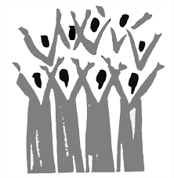
Spirituals are also Folk songs
Folk Songs express the life experience of a people in their own vocabularies and musical forms.
They are the fruit of the creative capacity of an entire people rather than just individuals.
Booker T. Washington said:
“The Negro spiritual has for the Negro race the same value as any folk song does for any people. It fosters race pride. They breathe a child-like faith in a personal Father along with the hope that the children of bondage will ultimately pass out of the wilderness of slavery into the land of freedom.”

Slide 7
The First Great Awakening (ca. 1730-1755)
A time when evangelism and revivals swept through the Protestant faiths in 13 Colonies to try and bring individuals closer to God.
The message of spiritual equality appealed to many enslaved peoples, and, as African religious traditions continued to decline in North America, Black people accepted Christianity in large numbers for the first time.
Many leaders of travelling revivals proclaimed that slaveholders should educate enslaved peoples so that they could become literate and be able to read and study the Bible. In this way, many Africans were finally provided with some sort of education.

Slide 8
I Want Jesus to Walk with Me #490 - A Journey Song
Slaves believed they had a personal relationship with Jesus and that He would help them deal with their pain and sorrow.
Former slave, turned preacher, Peter Randolph said:
“When I was a child, my mother used to tell me to look to Jesus, and that He who protected the widow and the fatherless would take care of me also. I thought He would talk with me and give me what I asked for. Being sickly, my greatest wish was to live with Christ in heaven, so I would go to the woods and lie upon my back, and pray that he would come and take me to himself. After a long while I felt very sorry that he did not come and talk with me and that I must have been the worst little boy that ever lived.”

Slide 9
The “visible” church vs. the “invisible” church
The Visible Church was that of the slave owners who could require the slaves to come to services on the grounds or in a local church building.
In some places, the owners would build a praise house for these services and even provide a preacher from time to time.
Sunday was the only day that most slaves had a day away from work – except for the “house slaves” who probably worked hardest to prepare large and elaborate meals for the owners’ family and friends.
They cleaned up, put on their best clothes, and went to church. One slave said:
“It was the onliest place off the farm we ever went.”

Slide 10
The Invisible Church
The enslaved would gather under the scrutiny of a
white overseer who would severely restrict their
prayers, sermons, and songs.
The services were sometimes conducted by a black
preacher who was allowed to come to white services in order to learn the scriptures and the messages that the owners wished them to speak about to the slaves.
“Real Church” was the totally secret meetings slaves would have in secret places. This was a very risky activity that would take place at night or early in the morning. If caught, slaves would be severely punished or traded to another owner.
Children might be stationed in trees as lookouts to warn of incoming white folk. Wet quilts were hung to muffle the sounds of praying and singing.
“The old folks used to slip out in the fields and thickets to have prayer meetings and my mother always took me along. They would all get around a kettle on their knees and sing and pray and cry.”

Slide 11
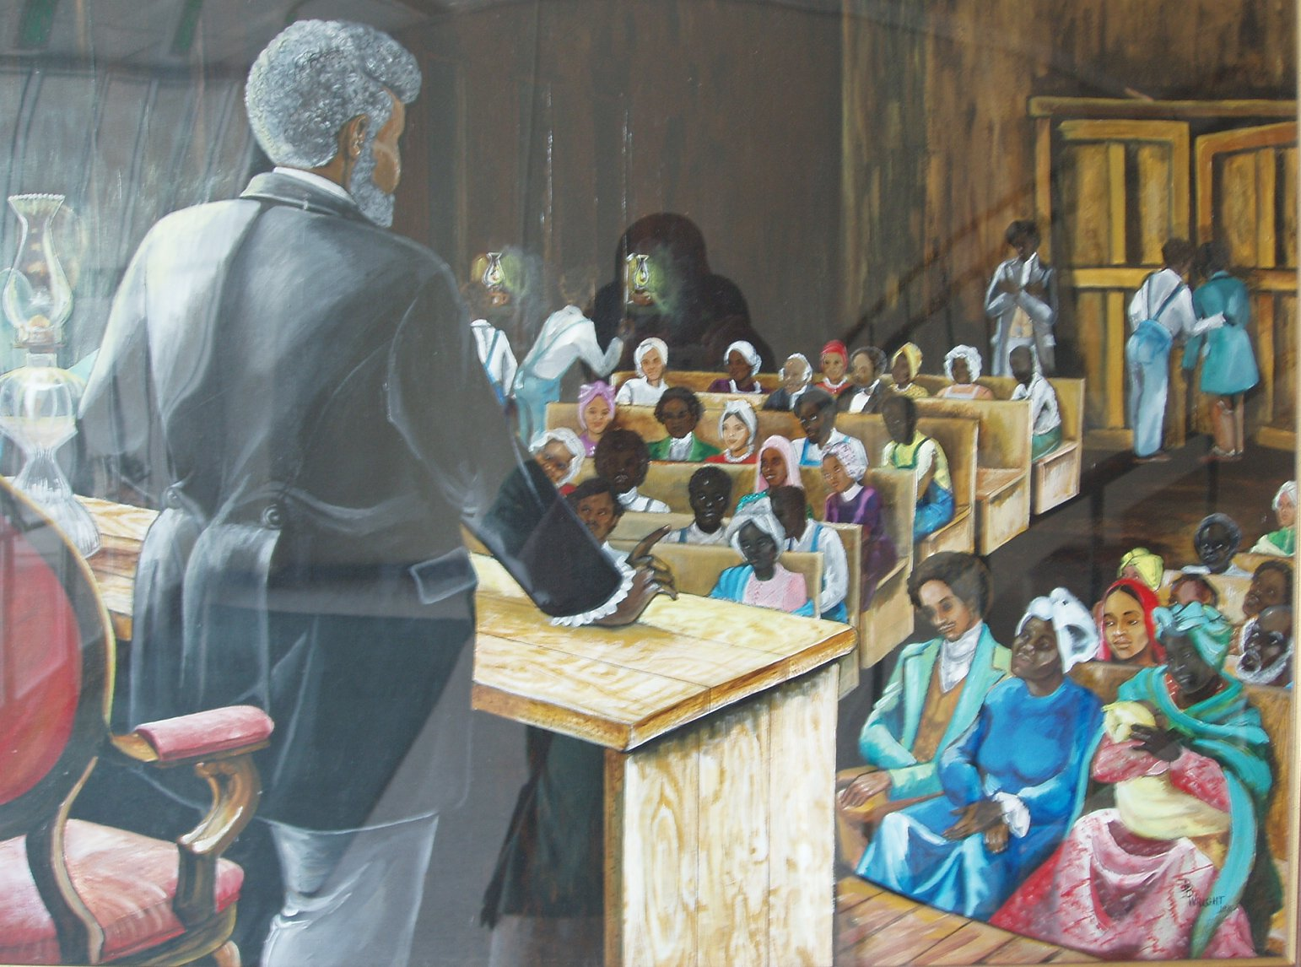
The Slave Preacher
Author and poet, Howard Thurman said:
“The antebellum Negro preacher was the greatest single factor in determining the spiritual destiny of their community. “
Author and activist, W.E.B. Du Bois wrote:
“The Negro preacher is the most unique personality developed on the American soil. He is a leader, a politician, an orator, an idealist and a giver of hope.”
He was the most respected in the slave hierarchy and often was allowed to travel from farm to farm over a wider area to provide spiritual and educational leadership.
He walked a very thin line between the needs of the enslaved and the desires of the slave owners.

Slide 12
Over My Head #514 Praise Song
Christian slaves sought every opportunity to praise God.
Sometimes they took real risks in order to gather in a meeting.
They drew necessary sustenance from these times to endure their day-to-day existence.

Slide 13
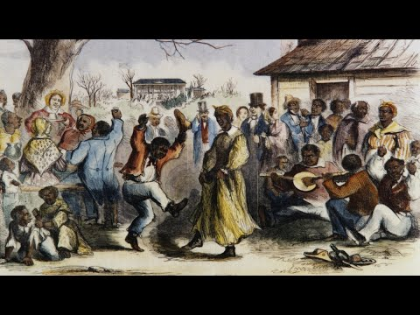
Conclusion
Using their African roots of rhythm and melody, the slaves loved to sing and dance with abandon, clap and shout, and repeat the words of the preacher.
“The slave’s life was so full of conflict that without religion or something like it, he could not have mentally or emotionally survived. Tough as he was, her needed an almost perpetual supply of spiritual nourishment.” – Author James Lovell
Christian religious conversion produced the fertile soil that gave us the Negro Spiritual.

Slide 15
Questions & Discussion

Slide 16
Oh, Freedom! A freedom song
1. Oh, freedom, Oh freedom, Oh, freedom over me.
Refrain: And before I’d be a slave I’d be buried in my grave, and go home to my Lord and be free!
2. No more weepin’
3. No more dyin’
4. There’ll be freedom,
“If I had my life to live over again, I would die fighting rather than be a slave, I want no man’s yoke on my shoulders no more”
-former slave, Robert Falls

