Slide 1
Spirituals 3
The Journey since Emancipation

Slide 2
Hold On – sung by CheckDEMout Work, Freedom and Perseverance song

Slide 3
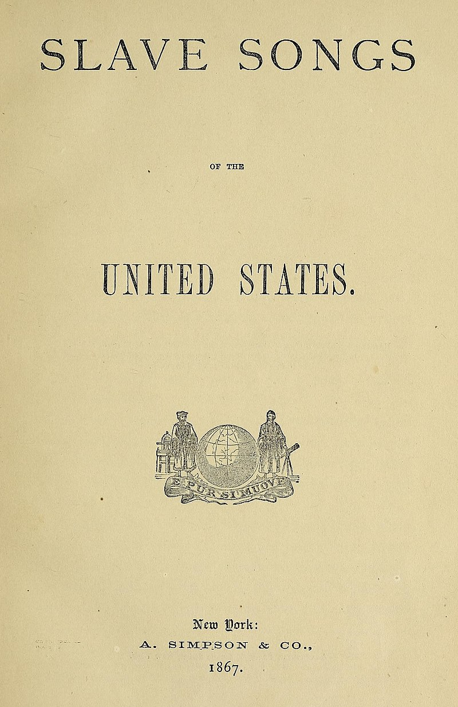
Spirituals after the Civil War
Published in 1867, Slave Songs of the United States was the first collection of Negro Spirituals to have music and lyrics written down. This was done by Charles P. Ware, Lucy McKim and William F. Allen.
They came to Port Royal, SC to witness the “Port Royal Experiment” – run by anti-slavery missionaries, teachers and administrators to prove that freed slaves could function as free people and citizens.
W.E.B. DuBois said:
“This was the first time the North met the Southern slave face to face and heart to heart with no third party as witness – and their singing stirred men with a mighty power.”

Slide 4
Guide My Feet #497 Freedom and Praise song

Slide 5
The Fisk Jubilee singers
Fisk University, one of the first college for blacks founded in Nashville, TN in 1866. They used converted military barracks to house and teach the students.
In desparate need of funding, the music professor (who was also the school’s treasurer) decided to take his singers on tour in 1871 – no small task at that time!
They encountered great difficulty finding transportation, food and housing, even in the Northern states.
They received little in donations, offerings and tickets sales until they got to Springfield, OH where a Presbyterian church gave them money, food and lodging.
In Oberlin, OH they received much needed financial help and were able to travel next to New York where they were an instant hit. Now they were in great demand.
President Grant invited them to sing at the White House in March of 1872. They then sang all over Europe and presented a concert for Queen Victoria in 1873.
The Fisk Jubilee Singers not only saved the University – but saved the Negro Spiritual from obscurity.

Slide 6
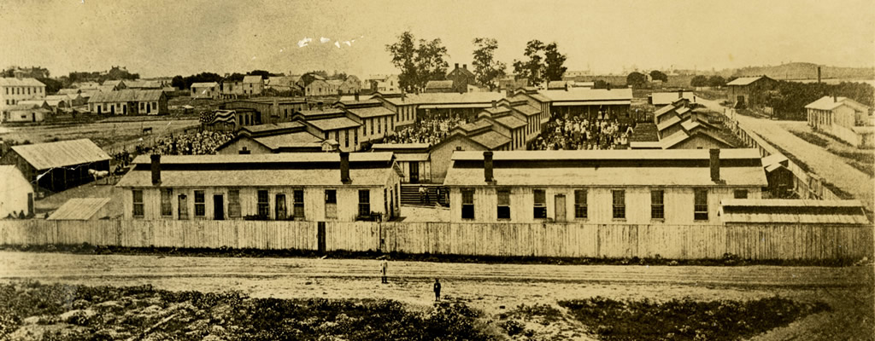
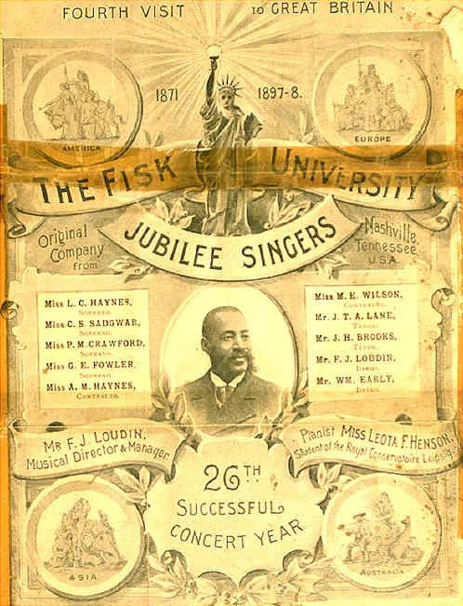
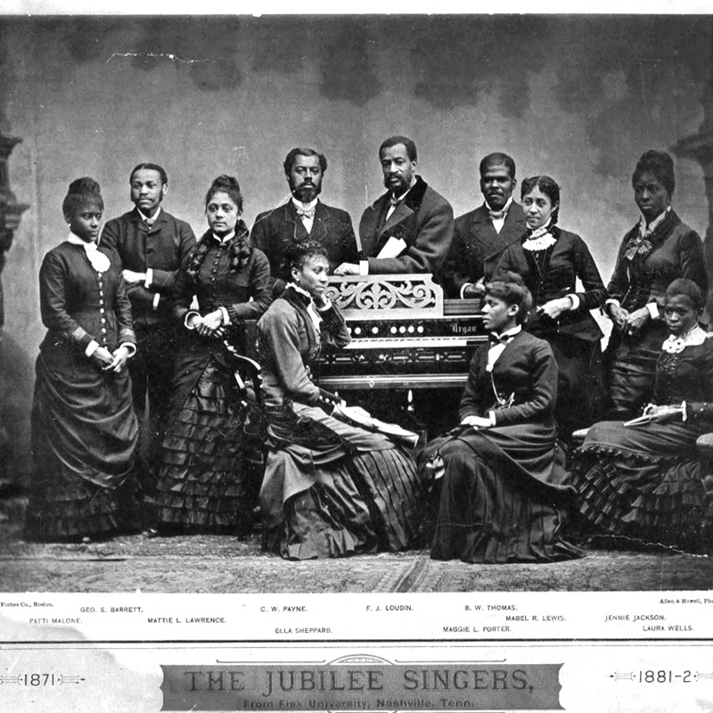

Slide 7
My Soul’s Been Anchored in the Lord The Fisk Jubilee Singers

Slide 8
Standing in the Need of Prayer #519 Call and response song
Praying gave slaves much comfort – a personal conversation with their Lord.
Sometimes owners looked down on praying because it was something they could not control or monitor. Slaves were often beaten if found praying.
Former slave William Robinson said:
“My mother had taught me to get on my knees and say my prayers, as far back as I can remember, yet I never knew the power there was in prayer.”

Slide 9
In 1874, Thomas Fenner, of the Hampton Institute in VA, pointed out that Spirituals were “rapidly passing away.” Understandably, the freed slave population was reluctant to re-live their painful past and preferred to sing other music that didn’t remind them of slavery.
He said:
“the freedmen have an unfortunate inclination to despise it as a vestige of slavery. Those who learned songs in the old time – when it was a natural outpouring of their sorrows and longings, are dying off. If efforts are not made for its preservation the country will soon have lost this wonderful music of bondage.”

Slide 10
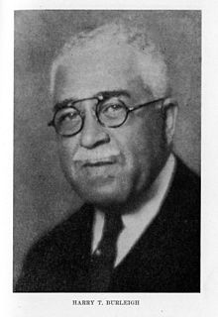
Spirituals arranged for Choirs and soloists Late 1800s and early 1900s
Fortunately, many Black College choirs followed in the footsteps of the Fisk Jubilee Singers and toured with arrangements of spirituals.
Composers and arrangers were needed to set these pieces to music.
The most famous arrangers and collectors of spirituals were:
Harry T. Burleigh (1866-1949) – born in Erie, PA
R. Nathaniel Dett (1882-1943) – at the Hampton Institute
John Wesley Work (1871-1925) – graduate of and teacher at Fisk (some say he composed “Go, Tell It on the Mountain”)
James Weldon Johnson (1871-1938), the poet, and J. Rosamund Johnson (1873-1954), the composer – also wrote “Lift Every Voice and Sing”
Harry T. Burleigh in 1936

Slide 11
Give Me Jesus #409 a praise and deliverance song
“In answer to the question ‘how did you bear it all, how did you live?’ the response was I couldn’t have done it without Master Jesus. He held me up. I’d a died long ago without Him.”
- former Alabama slave

Slide 12
Spirituals influence later styles of music – The Blues
If spirituals were the music of slavery, the blues were the music of Emancipation, Reconstruction, and the frustrated hopes which followed in the age of Jim Crow segregation.
Like spirituals, the blues affirmed the value of black lives in a society which systematically dehumanized them. Their main difference from spirituals was that the blues refused to describe Black live in terms of Christianity.
Devout black churchgoers frequently condemned the blues as the vulgar, depraved, and dirty music of the Devil, especially for their frank portrayal of sexuality.
The blues was the music of Saturday nights and the spirituals as the music of Sunday mornings. Yet many blues musicians would be greatly influenced by the church music they grew up with—particularly its format of call-and-response and altered melodic notes.
Ma Rainey, Mamie Smith, Ida Cox, Ethel Waters, Alberta Hunter, and Bessie Smith came to define the style of “classic blues” during the 1920s.
Play Bessie Smith recording with Louis Armstrong from 1925.

Slide 13
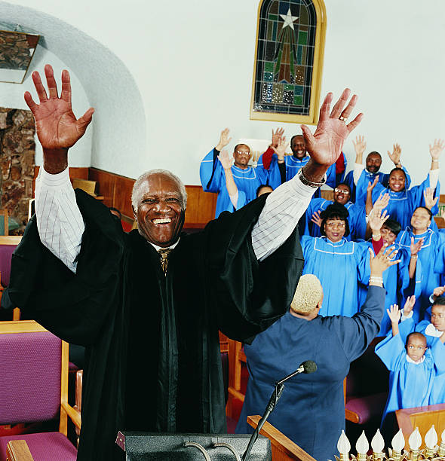
Spirituals Influenced other styles of Music Gospel music
African American spirituals were an important aspect in the lives of enslaved people.
Singing worshipful songs provided an escape from the cruel and uncaring treatment. However, it also played an essential role in communication. Enslaved individuals would use these songs to call out to others, and different responses allowed them to
transfer messages.
The spiritual influences - call-and-response style and syncopated rhythms - eventually evolved into modern gospel music. The genre officially got its start in the 1930s. Traditional styles utilized large choirs, who sang hymns and other worshipful songs. Individual singers also emerged, who were often partially backed by choirs so that the lead singer could exercise their full vocal abilities, much to the joy of the congregation.
Well-known gospel singer Mahalia Jackson (1911–1972) was one of Gospel music's most prominent proponents. She said: "Blues are the songs of despair. Gospel songs are the songs of hope. When you sing gospel music you have a feeling there's a cure for what's wrong. When you're through with the blues you've got nothing to rest on."

Slide 14
Spirituals influenced other forms of music – Ragtime and into Jazz
Ragtime is a musical style that flourished from the 1890s to 1910s. Its trait is its syncopated or "ragged" rhythm. Ragtime was popularized during the early 20th century and are typically composed for and performed on the piano.
Scott Joplin (ca. 1868–1917), the “Father of Ragtime” became famous through the publication of the "Maple Leaf Rag" (1899) and manyother hits such as "The Entertainer" (1902).
Ragtime was a modification of the marches made popular by John Philip Sousa, with additional syncopation rhythms coming from African music.
Spawned a style of music called “the Cakewalk” where couples strutting in fancy clothes was popular.

Slide 15
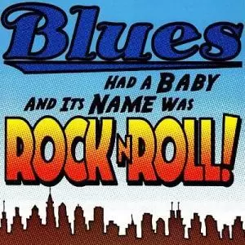
Spirituals Influence later styles of music - everything else
From Blues and Ragtime, the black experience move on to early Jazz styles with Dixieland in New Orleans and then moved up the Mississippi River to Memphis, St. Louis, and Chicago.
More sophisticated Jazz styles developed after that – Boogie Woogie, Swing, Big Band, bebop, cool and many others variations that we have today.
Blues in the 1940s through the 1960s morphed into a more rhythmic style called “Rhythm and Blues” - the term was originally used by record companies to describe recordings marketed to urban African Americans. R&B lyrical themes often encapsulate the African-American experience of pain and the quest for freedom and joy, as well as triumphs and failures in terms of relationships, economics, and aspirations.
Since then, artist have modified the sound to create soul, funk, rock ‘n roll, disco, Motown, hip hop, ska and whatever it is we have today.

Slide 16
Every Time I Feel the Spirit #282 Praise song and Pentecost song
The Holy Spirit gives life and provides inspiration
This affirms that, no matter the circumstances, whenever the Spirit is “moving in my heart, I will pray.”
“In slavery times, my master whipped me terribly, especially when he knew I was praying. He was determined to whip the Spirit out of me, but he never could. The more he whipped me, the more the Spirit made me happy.” – unknown slave

Slide 17
Gospel Music - Mavis Staples and Aretha Franklin sing “Oh, Happy Day”

