Slide 1
Spirituals 1
Slave History and the Songs they sing!

Slide 2
Go Down, Moses old testament Escape song
When Israel was in Egypt land; Let my people go!
Oppressed so hard they could not stand; Let my people go!
Go down, Moses! Way down in Egypt land
Tell old Pharaoh To let my people go!
"Thus spoke the Lord," bold Moses said, Let my people go!
"If not, I'll smite your first-born dead!“ Let my people go!
Go down, Moses! Way down in Egypt Land!
Tell old Pharaoh To let my people go!

Slide 3
In 1619 - the first Africans were brought to America. This was the beginning of 244 years of legalized slavery on U. S. soil.
Approximately 12.5 million Africans from almost every country with an Atlantic coastline were kidnapped and coerced into slavery and transported in about 35,000 slaving voyages.
Roughly 6% of all enslaved Africans transported via the slave trade arrived in the United States, both before and after the colonial era. The majority of these Africans came from the West African Slave Coast.
Some Africans were taken to be slaves in the West Indies, Dutch Guiana and Brazil.

Slide 4
In 1808 - the Transatlantic Slave Trade was abolished while slavery continued to be lawful in the US for another 55 years.
In the U.S., there was a "high and sustained natural increase in the slave population for a more than a century and a half—with numbers nearly tripling by the end of the domestic slave trade in the 1860s."
During that period, "approximately 1.2 million men, women, and children, the vast majority of whom were born in America," were displaced—spouses were separated from one another, and parents were separated from their children.
By 1850, most enslaved African Americans were "third-, fourth-, or fifth-generation Americans."

Slide 5
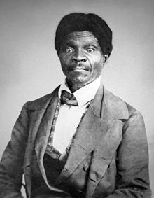
1857 - The Dred Scott Ruling determined that the US Constitution was not “intended” to protect people of African descent.
Chief Justice Roger B. Taney delivered the majority opinion and ruled that:
Any person descended from Africans, whether slave or free, is not a citizen of the United States, according to the U.S. Constitution.

Slide 6
1860 - The Republican party declared slavery itself to be “a crime against humanity” as part of their presidential campaign. Though nothing came of it, it is the first example of this term being used. 1863 - The Emancipation Proclamation freed slaves, but ONLY in the states that had seceded from the Union.
Let’s sing something!

Slide 7
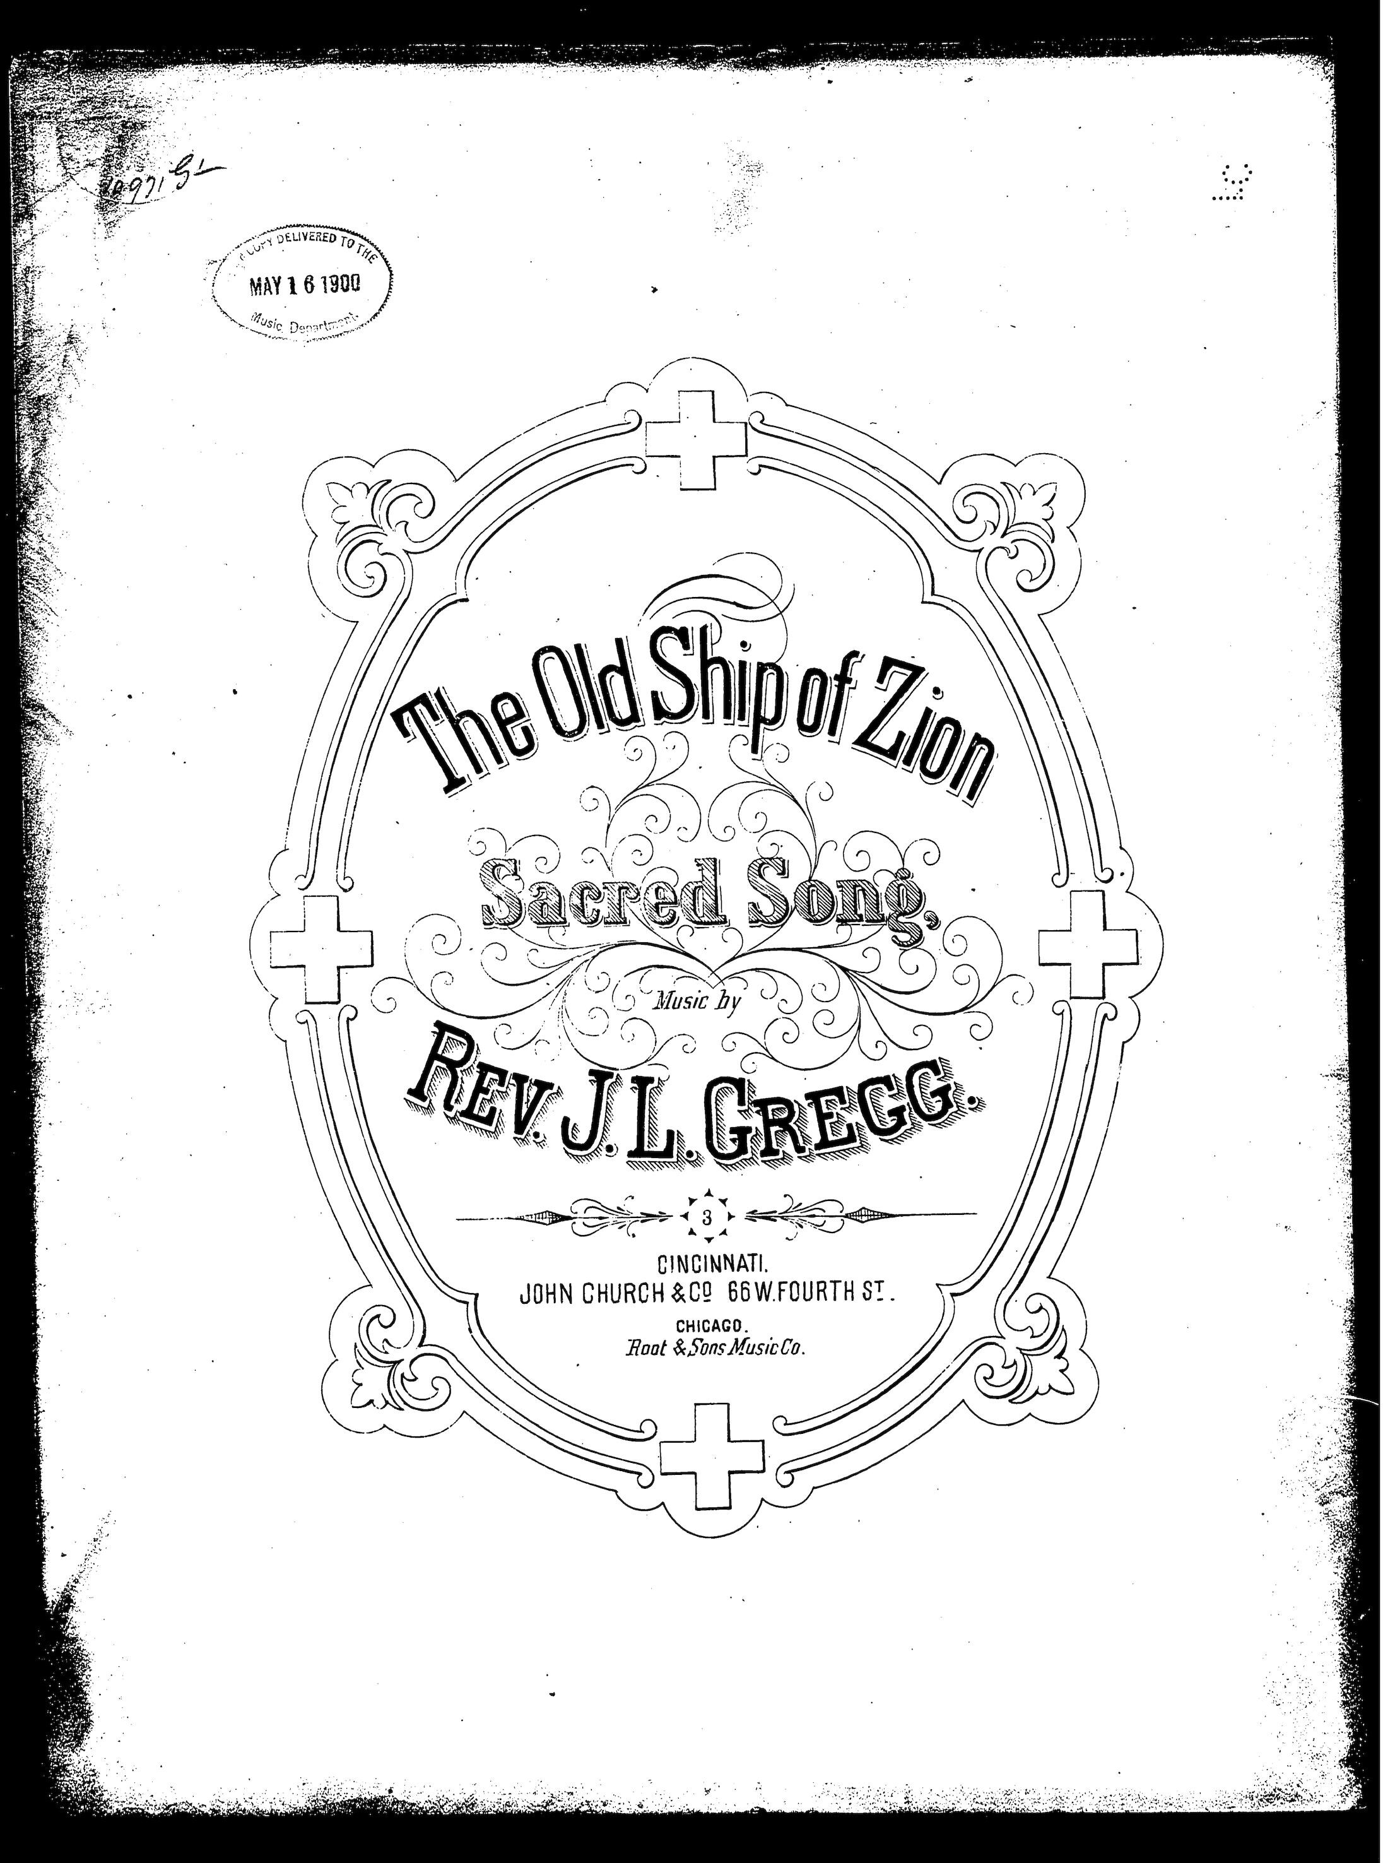
The old ship of zion (#310) a traveling song
Harriet Tubman referred to this Spiritual in a letter she wrote, using the pen name William Henry Jackson, to let her family members know she was coming back to get them.
“Read my letter to the old folks, and give my love to them and tell my brothers to be always watching unto prayer, and when the good old ship of Zion comes along, to be ready to step on board.”

Slide 8
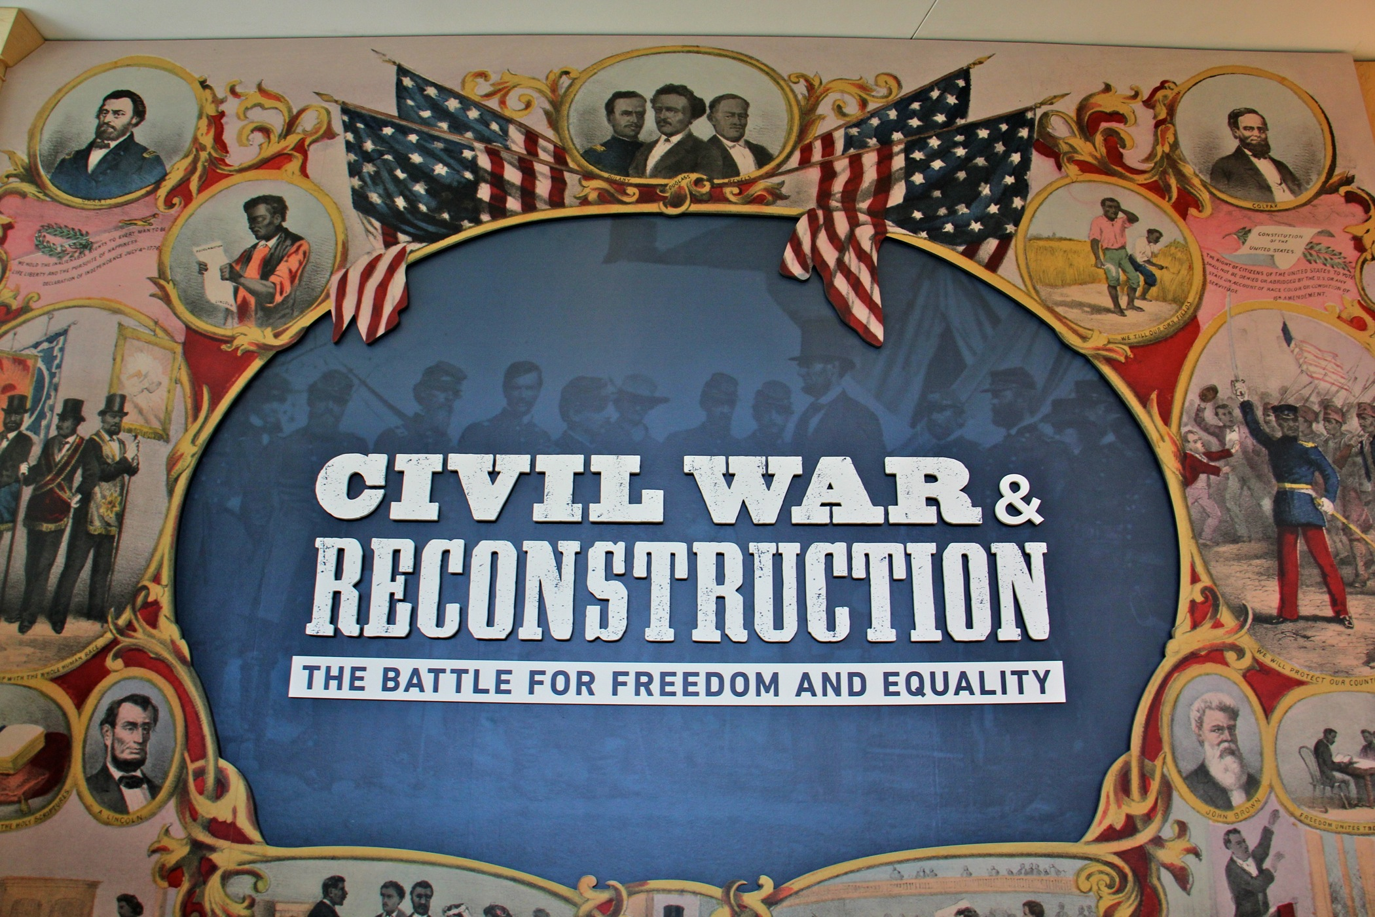
1865 – THE 13th Amendment abolished slavery and involuntary servitude in the US after 264 years. EXCEPT as a form of punishment for a crime.
1868 – the 14th Amendment nullified the Dred Scott decision and gave equal rights to everyone in federal, state and local jurisdictions. It’s what gets questioned today in decisions like Roe v. Wade, Bush v. Gore and Obergefell v. Hodges.
1870 – the 15th Amendment guarantees the right to vote regardless of race, color, or previous servitude. Still no voting for women?!?

Slide 9
Let Us Break Bread Together (#330) Code song with a double meaning
Slaves could sing what they could not say. Secrecy was essential for the slaves’ survival. “Breaking Bread” could be code for a secret meeting at a specific time and place.
Also, to slaves converted to Christianity, Communion held a great deal of significance. Singing this song was a reverent and humbling act where “falling on one’s knees” was very important.
In some places, slaves would be served Communion in the morning with their “faces to the rising sun” and then be beaten by the same hand that served them the bread and wine.

Slide 10
My Lord, what a morning, A judgement Day Song

Slide 11
This Little light of mine (#525) a joy of salvation song and a civil rights anthem
Some claim the song takes its theme from some of Jesus's remarks to his followers.
Matthew 5:14-16 of the King James Version gives: "Ye are the light of the world. A city that is set on a hill cannot be hid. Neither do men light a candle and put it under a bushel, but on a candlestick; and it giveth light unto all that are in the house. Let your light shine before men, that they may see your good works and give glory to your Father who is in heaven."
The parallel passage in Luke 11:33 of the King James Version gives: "No man, when he hath lighted a candle, put it in a secret place, neither under a bushel, but on a candlestick, that they which come in may see the light."

Slide 12
Any Discussion or Questions?

Slide 13
The Gift to Sing James Weldon Johnson - 1871-1938
Sometimes the mist overhangs my path,
And blackening clouds about me cling;
But, oh, I have a magic way
To turn the gloom to cheerful day—
I softly sing.

Slide 14
And if the way grows darker still,
Shadowed by Sorrow’s somber wing,
With glad defiance in my throat,
I pierce the darkness with a note,
And sing, and sing.

Slide 15
Brood not over the broken past,
Nor dread whatever time may bring;
No nights are dark, no days are long,
While in my heart there swells a song,
And I can sing.

